Slide 1
Director Appointments: It Is Who You Know
Jay Cai
LeBow College of Business, Drexel University
Tu Nguyen
School of Accounting and Finance, University of Waterloo
Ralph Walkling
Ohio State University and Drexel University
The Review of Financial Studies
March 2021
Presented by: Yan Li

Slide 2
Research Question:
Is it prevalent that directors are selected from the professional network of the incumbent directors?

Slide 3
Previous Literature
CEO involves in the director nomination process and the consequent agency implications: begin with the seminar work of Hermalin and Weisbach (1998), etc.
An individual director, like the board itself, represents a portfolio of skills and attributes: Fama and Jensen (1983) ; Agrawal and Walkling (1994); etc.
Companies may seek a particular expertise to fulfill firm needs when appointing a new director: Becher, Walkling, and Wilson (2019) ; Güner, Malmendier, and Tate(2008); Harford and Schonlau (2013); etc.
A growing literature examines the diversity of board composition and its impact on firm policies and performance: Adams and Ragunathan (2017), Faccio et al. (2016), Bernile, Bhagwat, and Yonker (2018), Giannetti and Wang(2019),and Eckboetal.(2019).

Slide 4
Hypothesis development
The coordination hypothesis
H1a: Boards are more likely to appoint a candidate with direct and strong connections to the incumbent directors, especially in complex, fast-changing situations where agile decision making can be crucial.
H1b: Firms appointing a connected director will experience higher announcement returns and receive higher shareholder votes, particularly when the coordination need is greater.
The search cost hypothesis
H2a: The probability of appointing a connected candidate increases with candidate quality(e.g., CEO or S&P500 board experience)and external search cost, which is higher for candidates with a background or experience different from the incumbent board. It is also higher for complex firms and firms in a more competitive environment.
H2b: Among potential candidates with second-degree connections, those connected to the incumbent board through a more reputable direct contact are more likely to be appointed.
H2c: Relative to unconnected candidates, potential candidates connected to the departing director are more likely to be appointed. This likelihood diminishes if the departing director leaves on bad terms.

Slide 5
Hypothesis development
The homophily hypothesis
H3a: Relative to unconnected candidates, the pool of connected candidates is on average more similar to the incumbent board along other dimensions, for example, in their experiences and industry backgrounds. H3b: Boards are more likely to appoint connected directors with similar experience and industry backgrounds to themselves.
H3c: The appointment of a connected director reduces firm value and receives lower shareholder votes. The impact is greater for an already homogeneous board and for complex firms and those in a more competitive environment.
The Agency hypothesis
H4a: Boards, in particular those serving under an entrenched CEO, are more likely to appoint candidates connected to the incumbent CEO.
H4b: The appointments of directors connected to incumbent CEOs reduce firm value and receive lower shareholder votes.

Slide 6
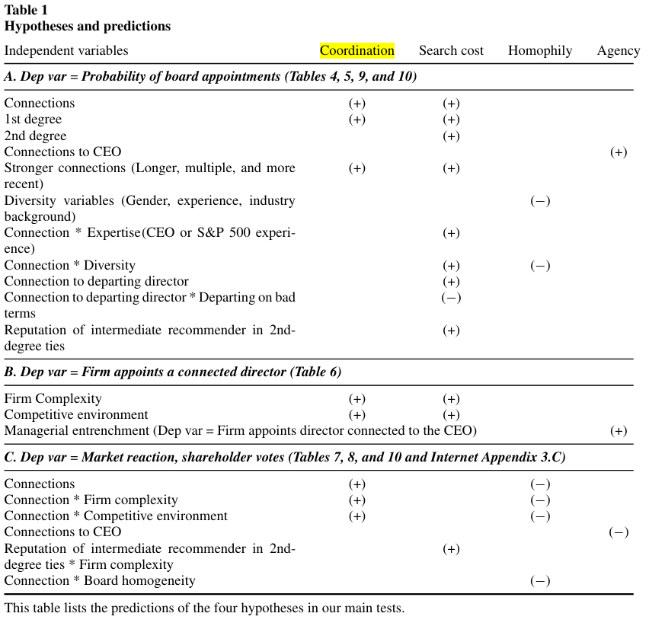
Hypothesis development
Both coordination and search hypotheses predict a higher probability of board appointments of connected candidates.
under both hypotheses, more complex firms and firms in more competitive environments are more likely to appoint connected directors.
Homophily hypothesis argues that Adding a connected director to the incumbent board reinforces the homogeneity of the board.
a CEO may be able to influence director nomination and have her friends appointed to the board

Slide 7
Data
The BoardEx database: a sample of 9,801 uncontested appointments of outside directors during the time period of 2003–2014
The RiskMetrics database: A subset of our sample firms (6,559 appointments) with information about shareholder votes on director elections
Compustat and the Center for Research in Security Prices (CRSP): firm data

Slide 8
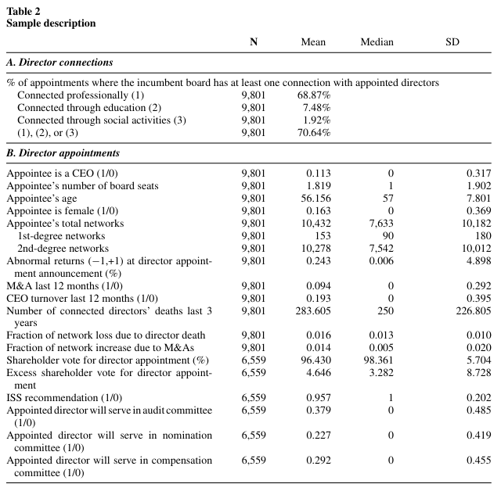
Firm and director characteristics
Panel A provides statistics of the types of connections (professional, educational, and social) between appointed directors and the incumbent board.
Focus on professional connections in subsequent analyses.
Panel B reveals that the typical appointee is a male, non-CEO, 56 years old, and holding 1.8 other board seats.

Slide 9
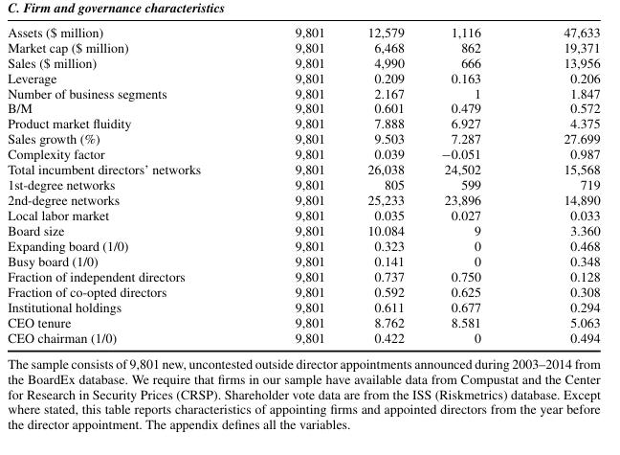
Firm and director characteristics
Panel C reports the average (median) size of the firms in our sample is $12 billion($1.1billion)with a book to market ratio of 0.60(0.48).

Slide 10
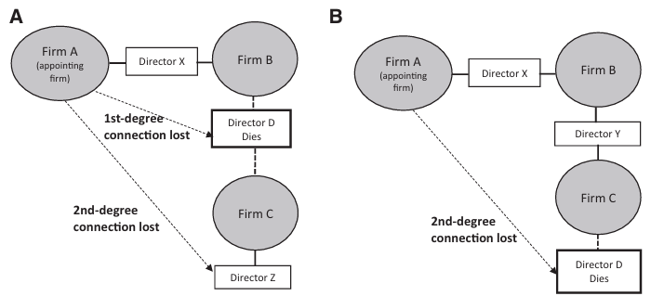
Instrumental variables _ Death of retired directors/executives
The first exogenous shock: use only the death of retired individuals and that of directors or executives whose current employers are no longer connected to the appointing firm
1. The deceased director(D) does not hold any executive or director position at the time of death. In this case, there is no natural replacement director for her. Director D had a past connection with the appointing firm’s director X and with potential candidate Z, among others. If the deceased director is the appointing firm’s first-degree connection (panel A), her death leads to the loss of appointing firm’s (second-degree) connection to potential candidates through her, as well as the (first-degree) connection to her. If the deceased director is the appointing firm’s second-degree connection (panel B), her death leads to the loss of only that one connection.

Slide 11
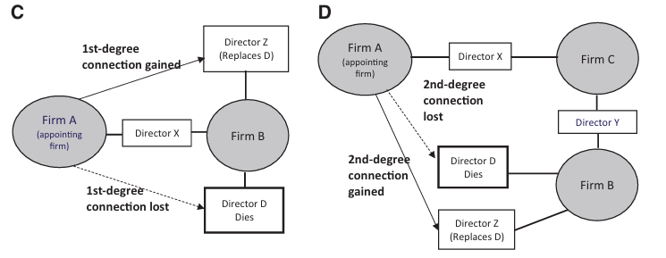
Instrumental variables _ Death of retired directors/executives
The first exogenous shock: use only the death of retired individuals and that of directors or executives whose current employers are no longer connected to the appointing firm
2. The deceased director (director D) is an executive or director of a firm (B) which is still connected to the appointing firm (A) through other individuals. Firm B will find a replacement for her and, by definition, the replacement (director Z) would be connected to firm A. As illustrated in panels C and D, while firm A loses the connection to the deceased director D and her other connections outside of firm B, it also gains the connection to the replacement director Z and her other connections. In this case, the death on average should have little effect, except the deceased director might have a greater or lesser network than the replacement director. These cases are excluded from the construction of the instrument.

Slide 12
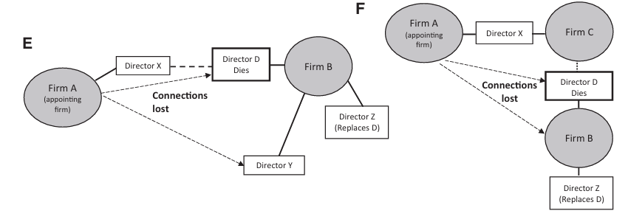
Instrumental variables _ Death of retired directors/executives
The first exogenous shock: use only the death of retired individuals and that of directors or executives whose current employers are no longer connected to the appointing firm
3. The deceased director D is an executive or director of a firm (B) that is the only connection to the appointing firm (A) via a past connection to director X. After the death of director D, firm A is no longer connected to firm B. As illustrated in panels E and F, while firm B will find a replacement for the deceased director D, the replacement director Z is unlikely to come from firm A or firm A’s network and, therefore, has little impact on firm A’s network. Thus, the associated first- and second-degree connections are lost.
We consider only scenarios 1 and 3 in the construction of our instrument and exclude the death cases in scenario 2

Slide 13
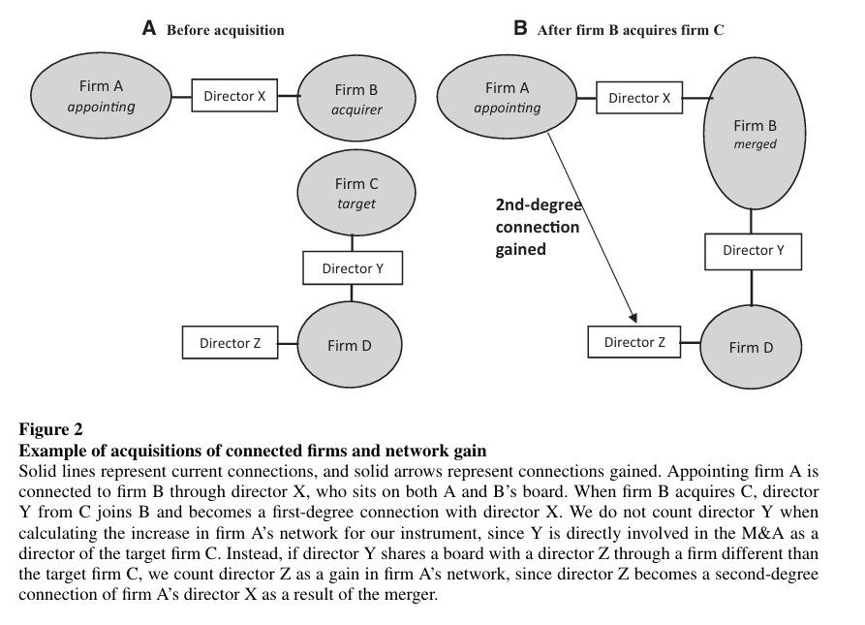
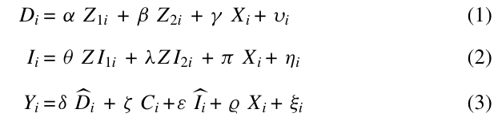
Instrumental variables _ mergers and acquisitions
The Second exogenous shock: mergers and acquisitions
Z_{1i} and Z_{2i} are the two instruments; C_{i} the coordination need variable

Slide 14
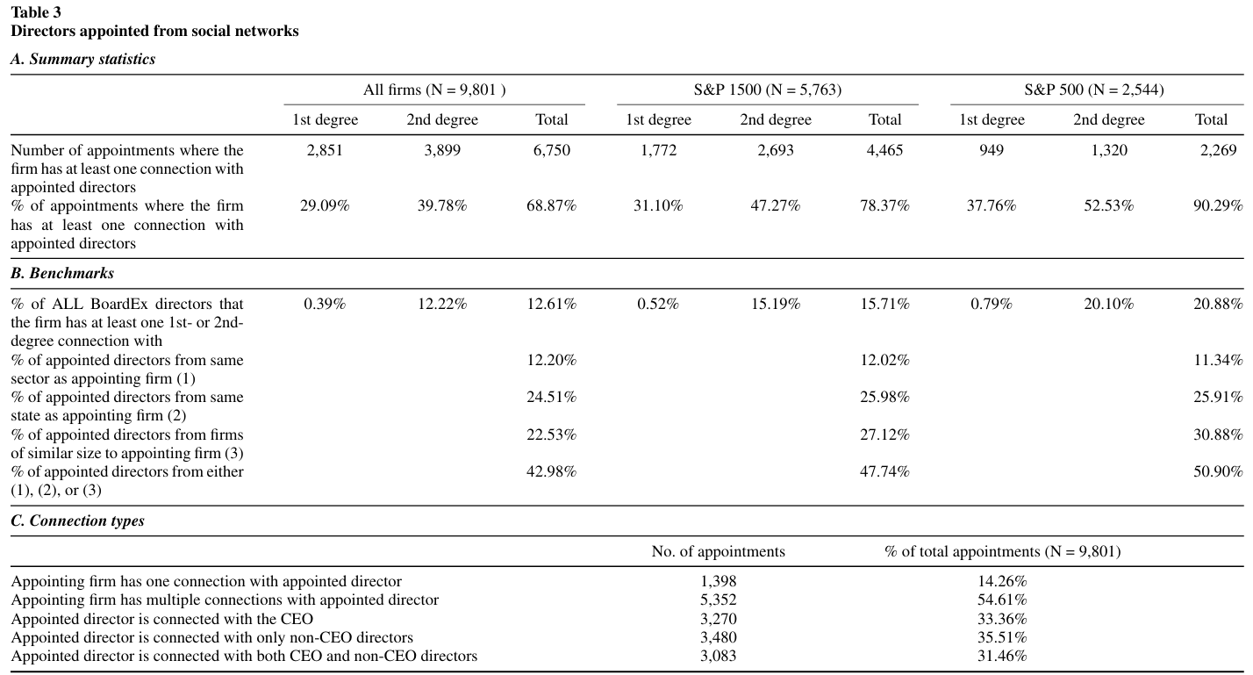
How do connections affect director appointments?

Slide 15
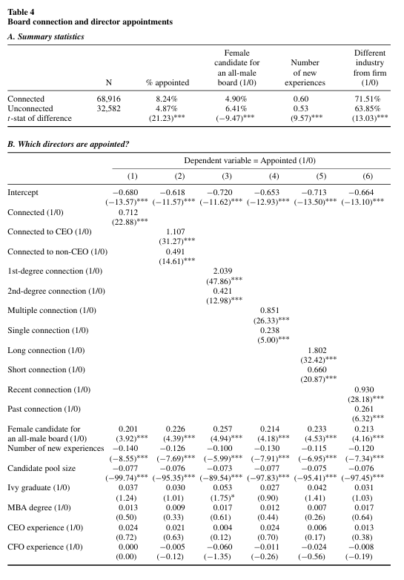
How do connections affect director appointments?
Among the connected candidates, about 8.2% are appointed, while only 4.9% of unconnected candidates are appointed.
Connected directors are significantly more likely to be appointed to the board.
Coefficient is positive and statistically significant for the gender diversity variable in all six specifications, suggesting boards on average seek gender diversity
A director with a new experience has 13% lower odds of being recruited than a director who has similar experiences as the incumbent directors, implying that boards on average appoint directors whose background is similar to their own

Slide 16
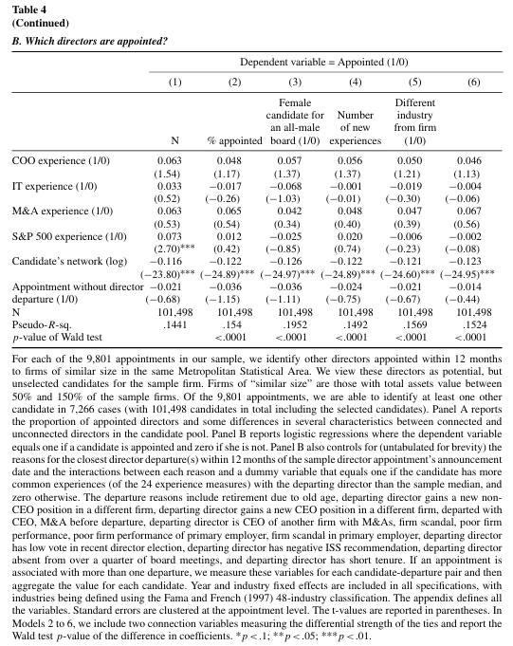
Which directors are appointed

Slide 17
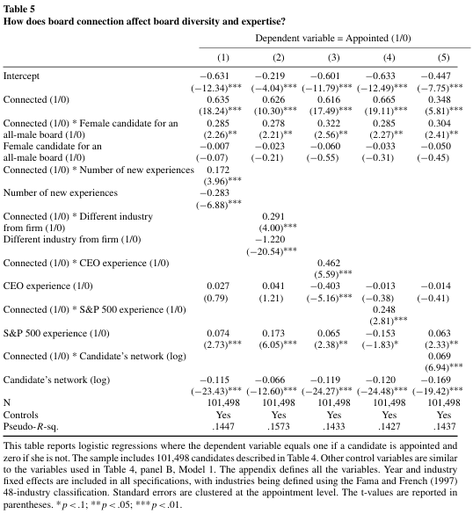
How does board connection affect board diversity and expertise?
The odds of a female being appointed to an all-male board are 33% higher for a connected candidate than a nun-connected one, suggests that an all-male board tends to appoint a female candidate who had previously worked with at least one of the incumbent directors
Boards on average are more likely to appoint a director with similar experience to their own but connections help to alleviate this tendency.
Models 1 and 2 suggests that networks reduce boards’ tendency to appoint directors similar to themselves and facilitate recruiting directors who add gender diversity, new skills and experience.
Models 3 and 4 indicates that boards are more likely to appoint a connected candidate if the candidate is of high value to the firm

Slide 18
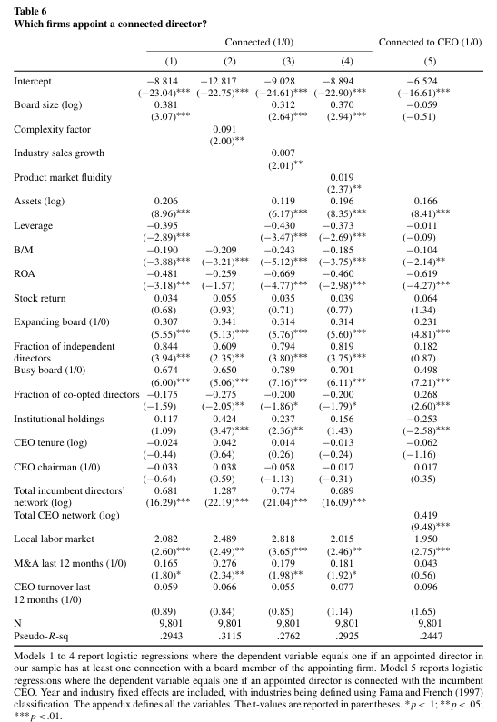
Which firms appoint a connected director?
Product market fluidity: a measure of how intensively the product market around a firm is changing in each year
B/M: a characteristic of faster growth
Column 1 to 4: firms with greater coordination need or higher search costs are more likely to appoint directors connected to the incumbent board.
Column 5:
Firms with more independent directors are not more likely to appoint a new director connected to the CEO;
A more co-opted board is more likely to appoint a new director connected to the CEO, but not connected to other board members.
Firms with more institutional holdings are less likely to appoint a director connected the CEO

Slide 19
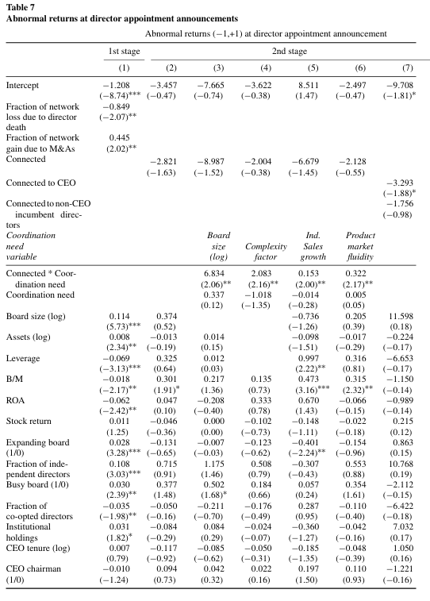
Abnormal returns at direct or appointment announcements
the fraction of death (merger-) induced network loss instrument is negatively (positively) correlated with the likelihood of appointing a connected director
An insignificant coefficient for the instrumented connected appointee variable, suggesting that the market on average does not view these appointments negatively
Positive abnormal returns for all interaction term between connected and coordination need( board size, complexity factor, sales growth, product market fluidity)

Slide 20
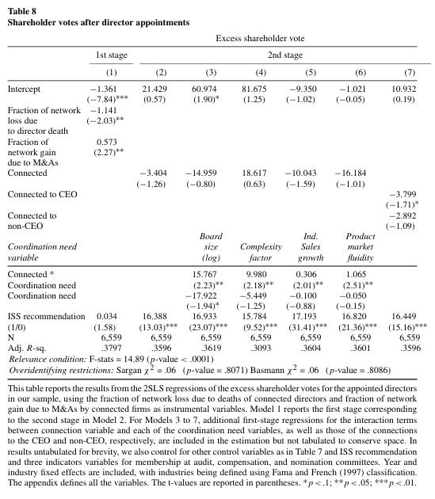
Shareholder votes for director appointments
Shareholders of the more complex firms (with a larger board or a greater complexity factor) are more likely to give significantly higher votes for the appointment of connected directors
If the firm is in a high growth industry or in a highly fluid market, shareholder votes is higher for directors connected to the incumbent board

Slide 21
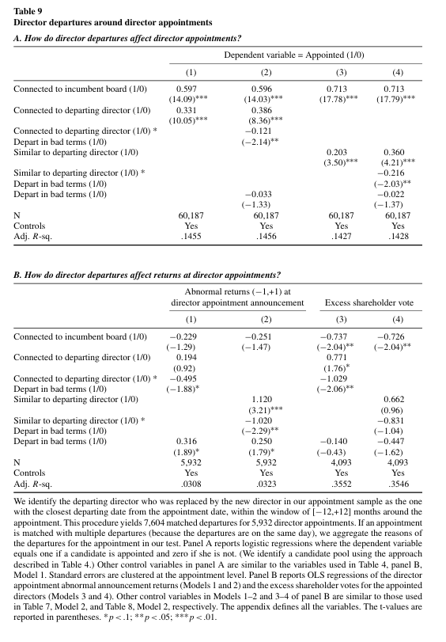
How do director departures affect director appointments?.
Panel A:
A director departing a firm on bad terms is less likely to successfully recommend a colleague to the firm or to recommend the firm to a colleague.
Boards on average tend to find a similar replacement, but the tendency is lowered if the director leaves the firm on bad terms.
Panel B:
Market participants react negatively when a firm does not make necessary changes.

Slide 22
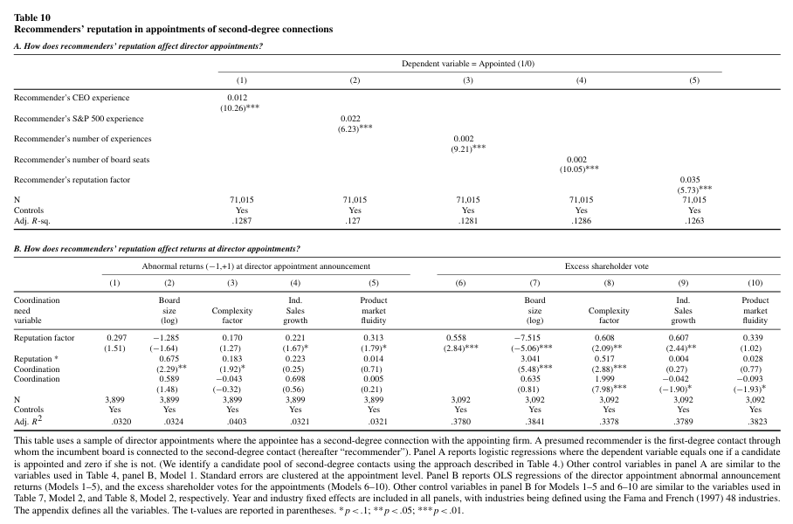


Recommenders’ reputation in appointments of second-degree connections
Panel A:
For a candidate with second-degree connections of the appointing firm, the chance of her being appointed increases with the reputation of her recommender
Panel B:
Greater shareholder voting support for the appointment of a second-degree connection of the board recommended by a more reputable or experienced first degree contact
For complex firms, market participants value the appointment of a second-degree connected director

Slide 23
Conclusions
Nearly 69% of director nominees are selected from the board’s networks, which on average comprise only 13% of the potential talent pool, especially for large firms.
In the absence of a connection, incumbent directors tend to recruit candidates with characteristics similar to their own, limiting the diversity and skill set of the board.
Connections appear to play a critical role in recruiting candidates who have different gender, skills, and industry background from the incumbent board
Complex firms and firms operating in a more competitive environment tend to appoint directors connected to the incumbent board. Such appointments also receive a more positive market reaction and higher shareholder votes.
Further, firms are more likely to appoint a connected candidate if the candidate clears a certain threshold for suitability or ability.
Boards controlled by the CEO are more likely to appoint a director who has personal connection to the CEO. In addition, the market and shareholders react negatively to the appointments of these directors.

Slide 24
Thank you!

